Slide 1
G5 - Smart Office Cleaner Robot

Slide 2
Table of Contents
Product Model
Circuit Layout
Application Interface
Estimated Budget

Slide 3
Objective
Main goal is to prepare robust, inexpensive affordable product with better efficiency

Slide 4
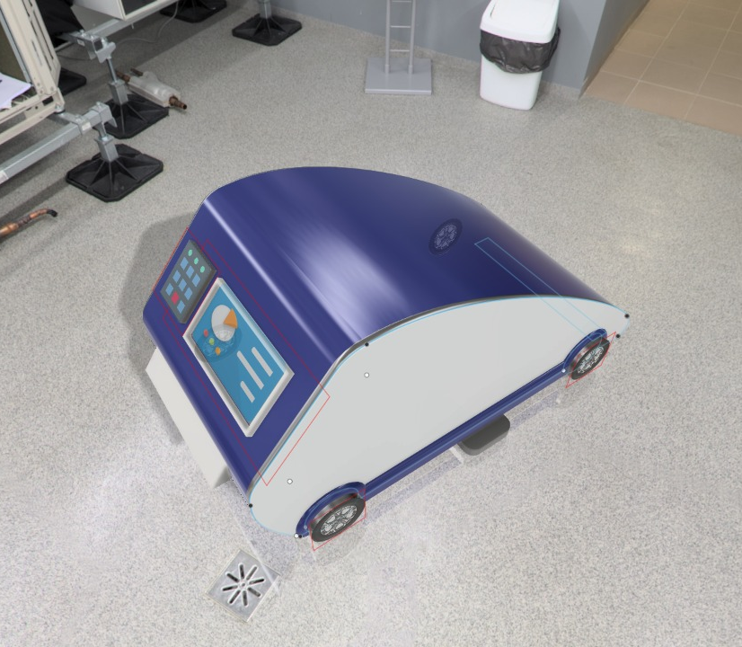
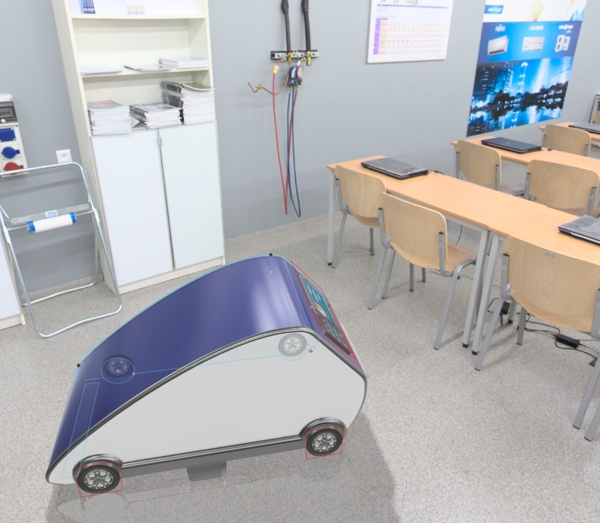
Product Model

Slide 5
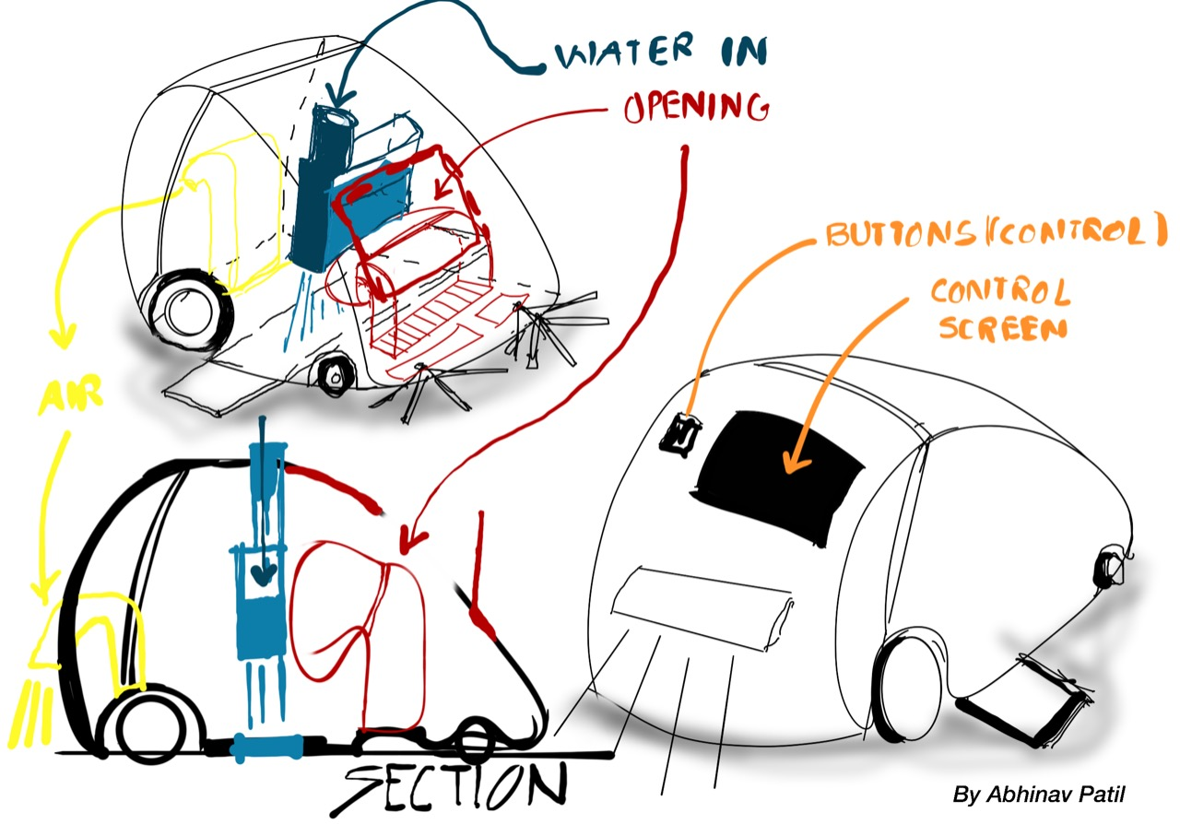
Proposed Design

Slide 6
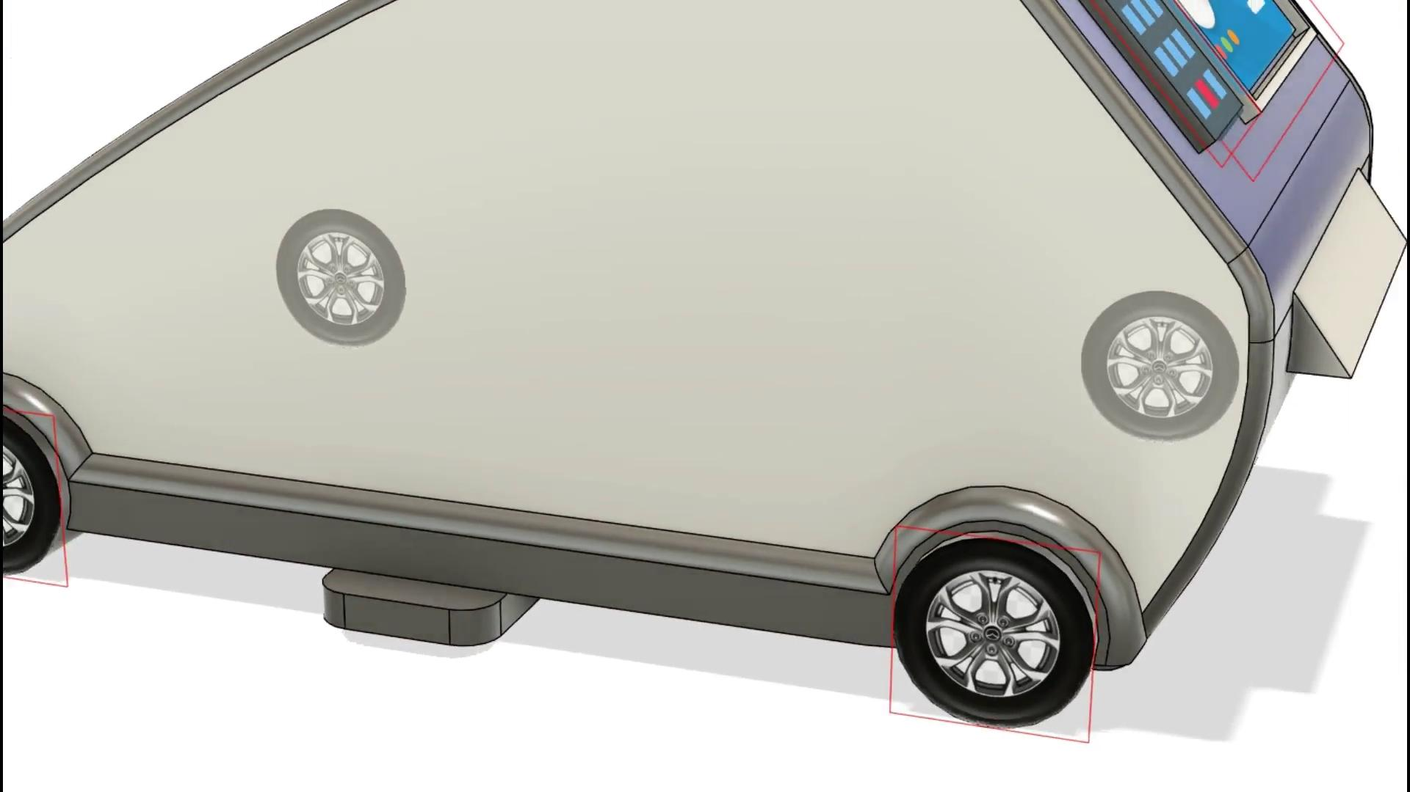

Slide 7
COMMUNICATION BETWEEN MICROCONTROLLER AND
APPLICATION
SENSORY INPUT TO MICROCONTROLLER
WELL CALCULATED, PRECISE WORKING OF THE CLEANER ROBOT
EFFECTIVE FEATURES AND MECHANISMS
PROCESSING AND MAPPING USING INPUTS FROM MICROCONTROLLER
OPERATION METHODOLOGY

Slide 8
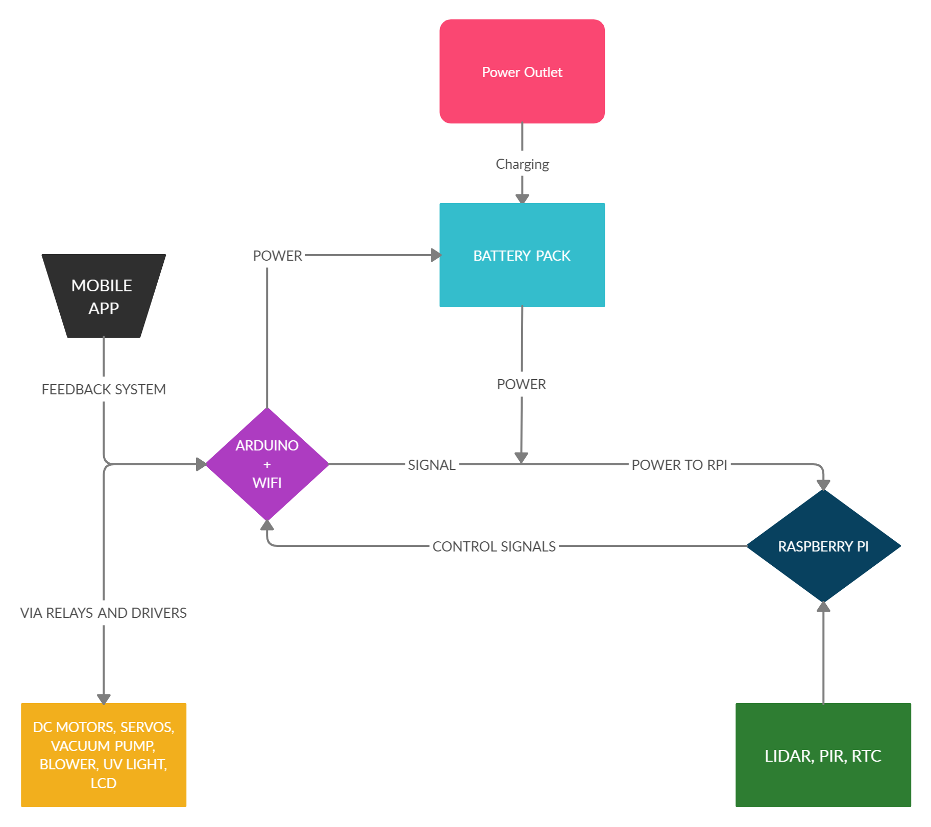
Circuit Block Layout

Slide 9
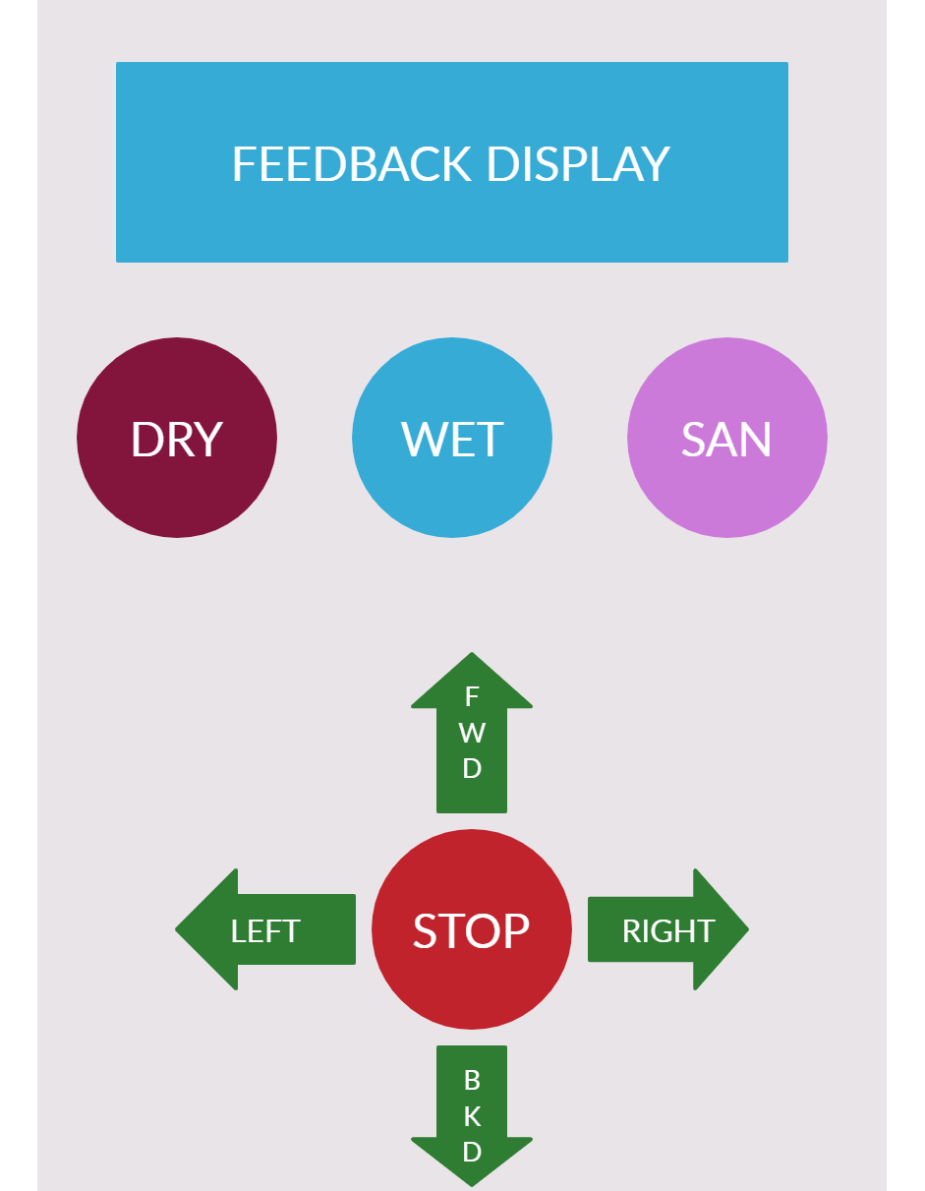
APP LAYOUT

Slide 10
Estimated Budget
Electronics Components - Rs.15000
Manufacturing Cost - Rs.3000
Miscellaneous - Rs.2000
Total Estimated - Rs.20000

Slide 11
Project timeline
Week 1
Week 2
Week 3
Week 4
Research & Planning
Robot Design
And Circuit Preparation
Product Animation,
Circuit and Software Simulation
Final Concept Presentation and Research Paper Publication

Slide 12
Cycle diagram
04
Prototype
Refine
01
03
Display
Get feedback
02

Slide 13
Thank you!

